Slide 1

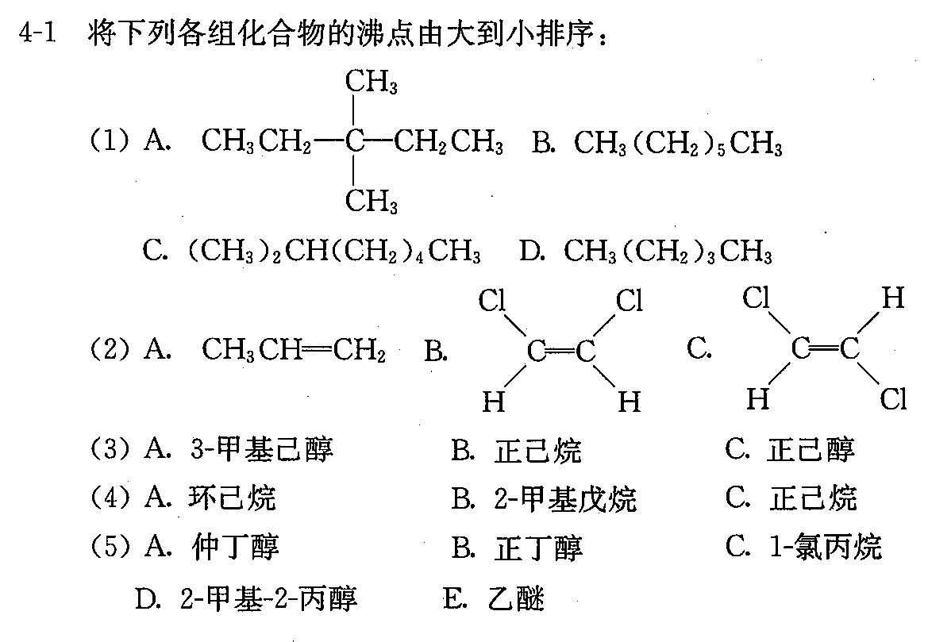
(1) C>B>A>D
(3) A.3-甲基己醇> C.正己醇 > B.正己烷
(5) B.正丁醇(117度) > A.仲丁醇(99) > D.2-甲基-2-丙醇(82) >C.1-氯丙烷(47) > E.乙醚 (34)

Slide 2
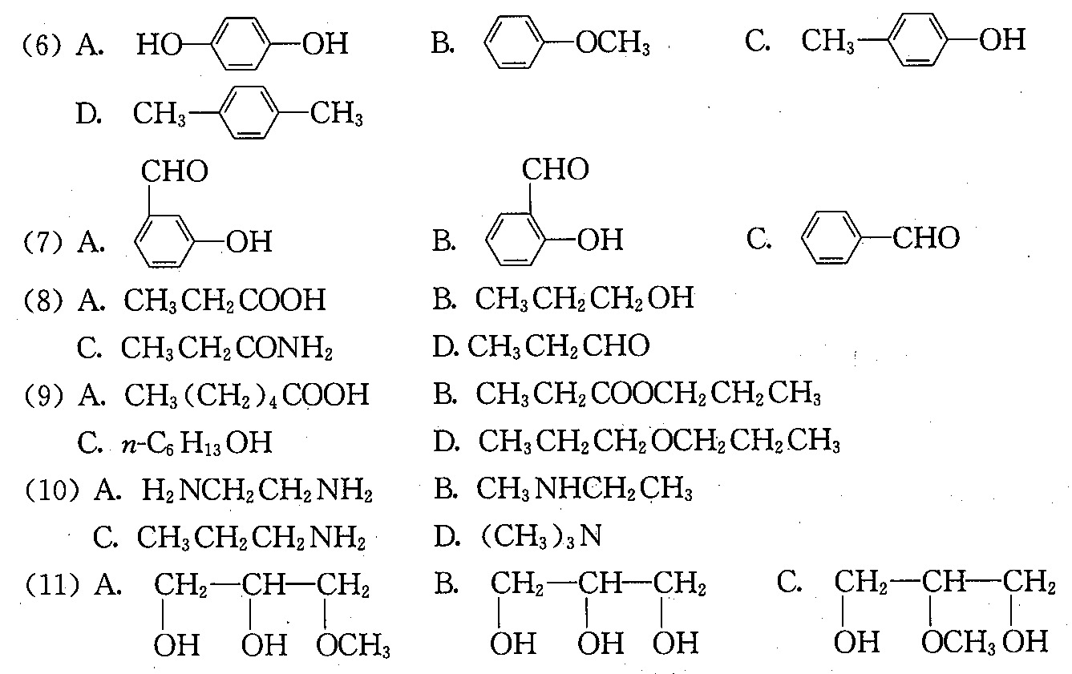
(7) A>B>C
(9) A>C>B>D
(11) B>C>A

Slide 3
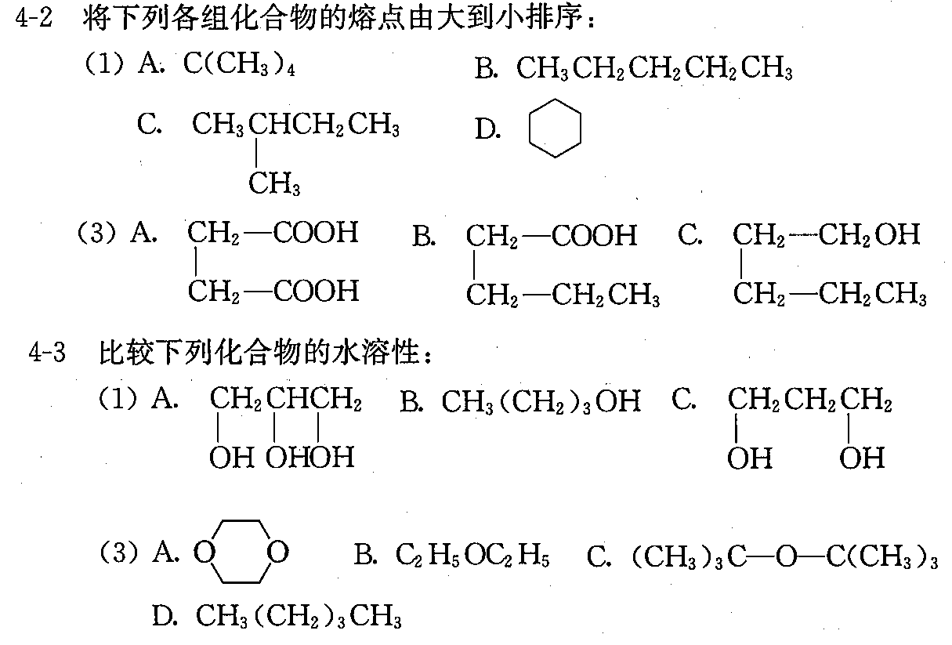
(1) D>A>B>C
(3) A>B>C
(1) A>C>B
(3) A>B>C>D

Slide 4
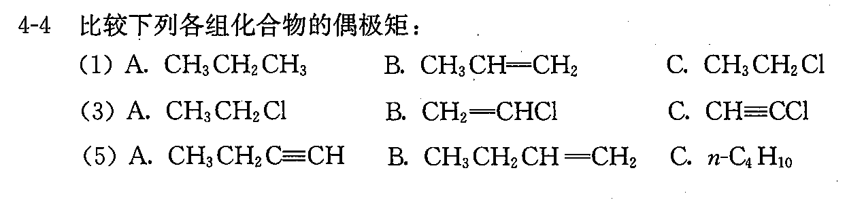
(1) C>B>A
(3) A>B>C
(5) A>B>C

